Slide 1
Environments of z~0.2 SF Galaxies: Building on the Citizen Science Discovery of the Green Peas
Carie Cardamone
Wheelock College
with Meredith Powell, Nico Cappelluti & Meg Urry @ Yale
With thanks to the Galaxy Zoo Team and over 200,000 volunteers including: Elisabeth Baeten, Gemma Coughlin, Dan Goldstein, Brian Legg, Mark McCallum, Christian Manteuffel, Richard Nowell, Richard Proctor, Alice Sheppard, and Hanny van Arkel
Notes:
http://www.theskyscrapers.org/astroassembly
Today not trad sci talk (introduce the problem of understanding how galaxies form and evolve and showing you how my work contributes towards that understanding), Rather going to take opportunity to introduce Citizen Science (specifically Galaxy Zoo, project I’m involved in) and use some of my research to show how CitSci can enable new and exciting research results.
Why Now? It’s a loaded term among academics, and often not understood what it is, Hot topic in funding agencies (and highlighted in decadal review – but! Incorrectly!)
Decadal Review: Astro2010 p101The internet plays a pervasive role for public astronomy, attracting world-wide audiences on websites such as Galaxy Zoo (www.galaxyzoo.org, last accessed July 6, 2010) and on others that feature astronomical events, such as NASA missions. - although they mislabeled a Vorverpe a Green Pea (emission line cloud!!!! Vs a galaxy)
Green Peas & Galaxy Evolution: Discoveries of Citizen Science
Abstract: I will introduce the Galaxy Zoo Citizen Science project and discuss some new discoveries being made through collaborations with Citizen Scientists. I will present a class of rapidly growing emission line galaxies, known as ‘Green Peas’, first noted by volunteers in the Galaxy Zoo project because of their peculiar bright green colour and small size. Their appearance is due to very strong optical emission lines, namely [OIII] λ5007 Å, with an unusually large equivalent width of up to ∼1000 Å. The Peas have some of the highest specific star formation rates seen in the local Universe, yielding doubling times for their stellar mass of hundreds of Myr. Due to their similarity in size, mass, luminosity to high-redshift ultraviolet-luminous galaxies, e.g. Lyman-break galaxies and Lyα emitters, studying these starbursting galaxies can help us to understand the build up of stellar mass in the Universe.

Slide 2
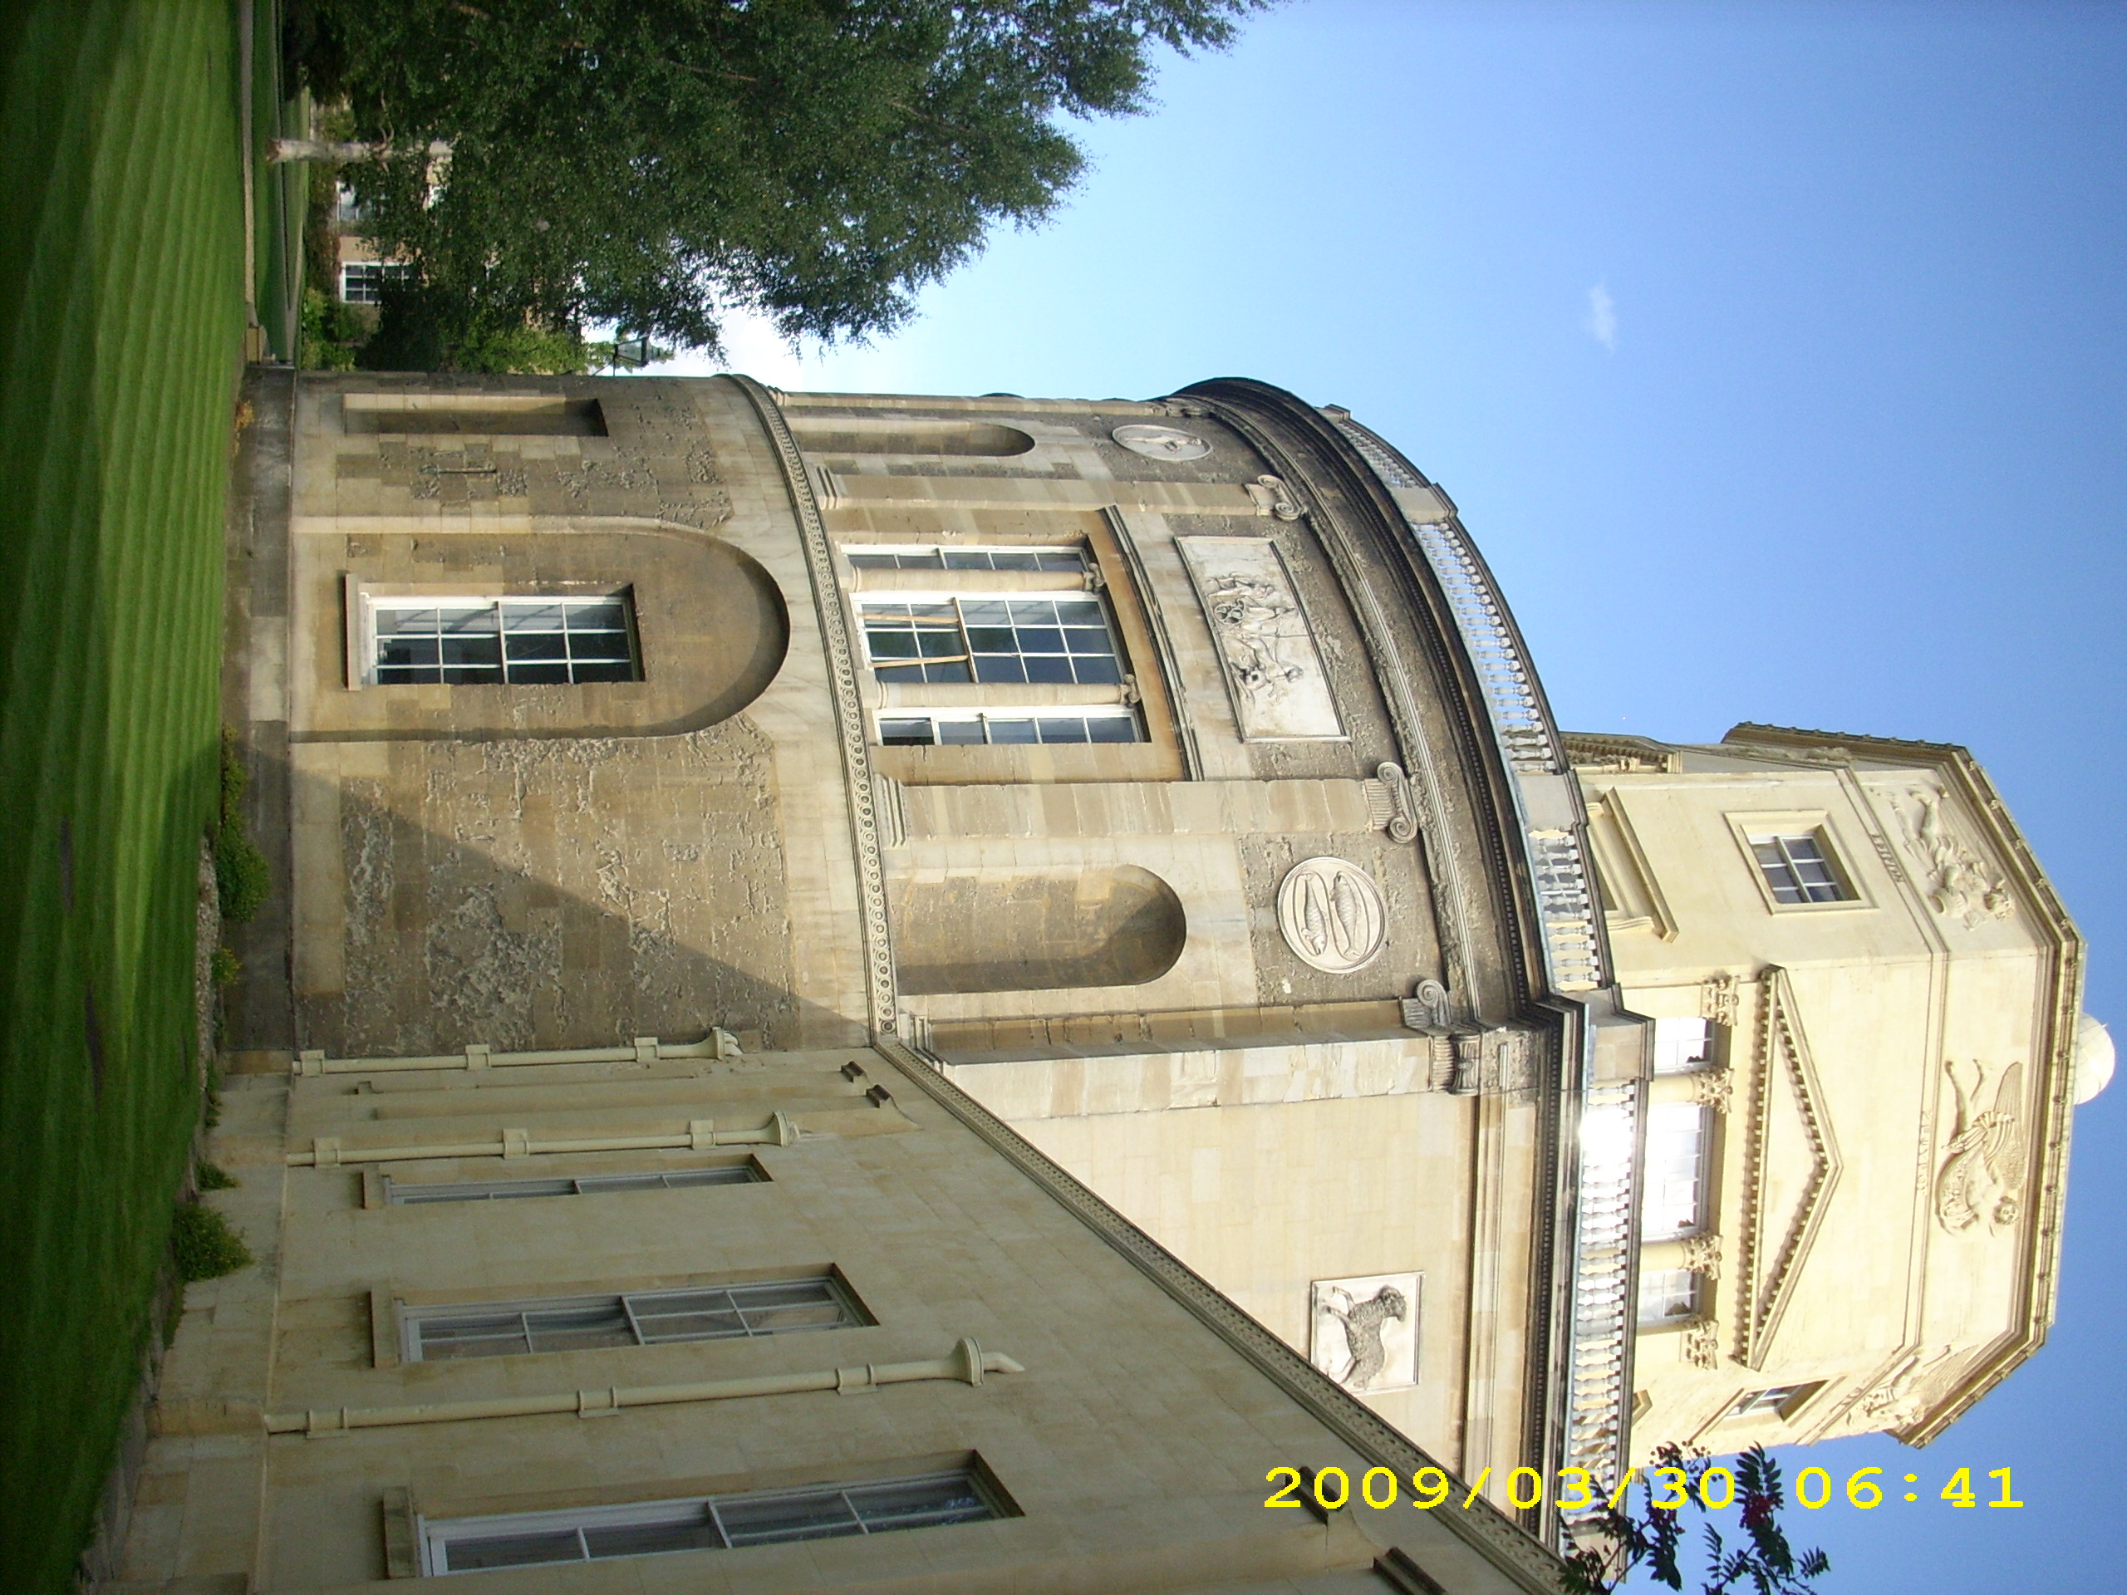
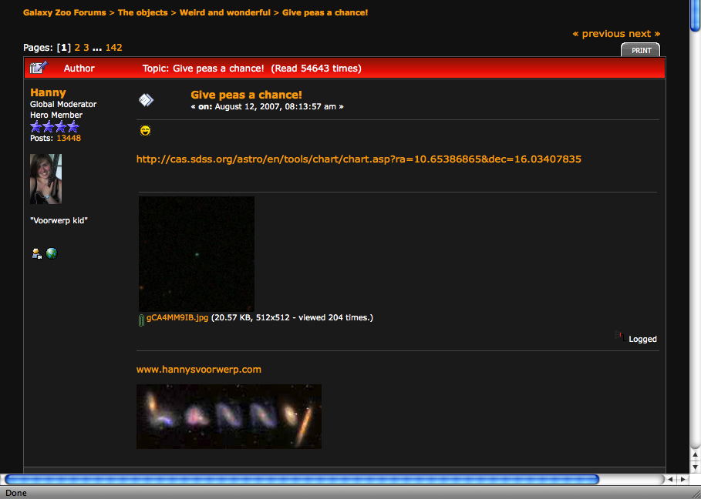
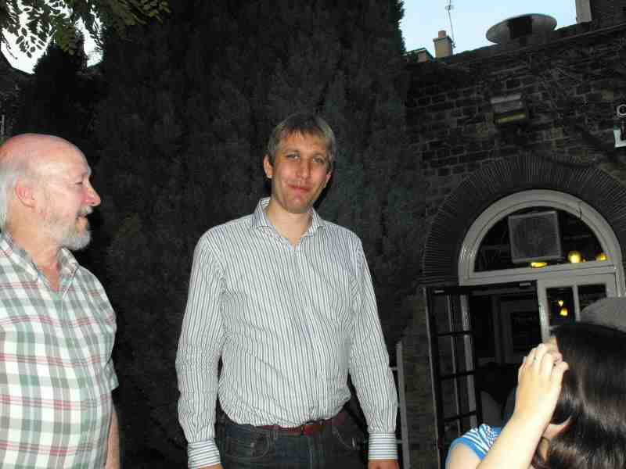
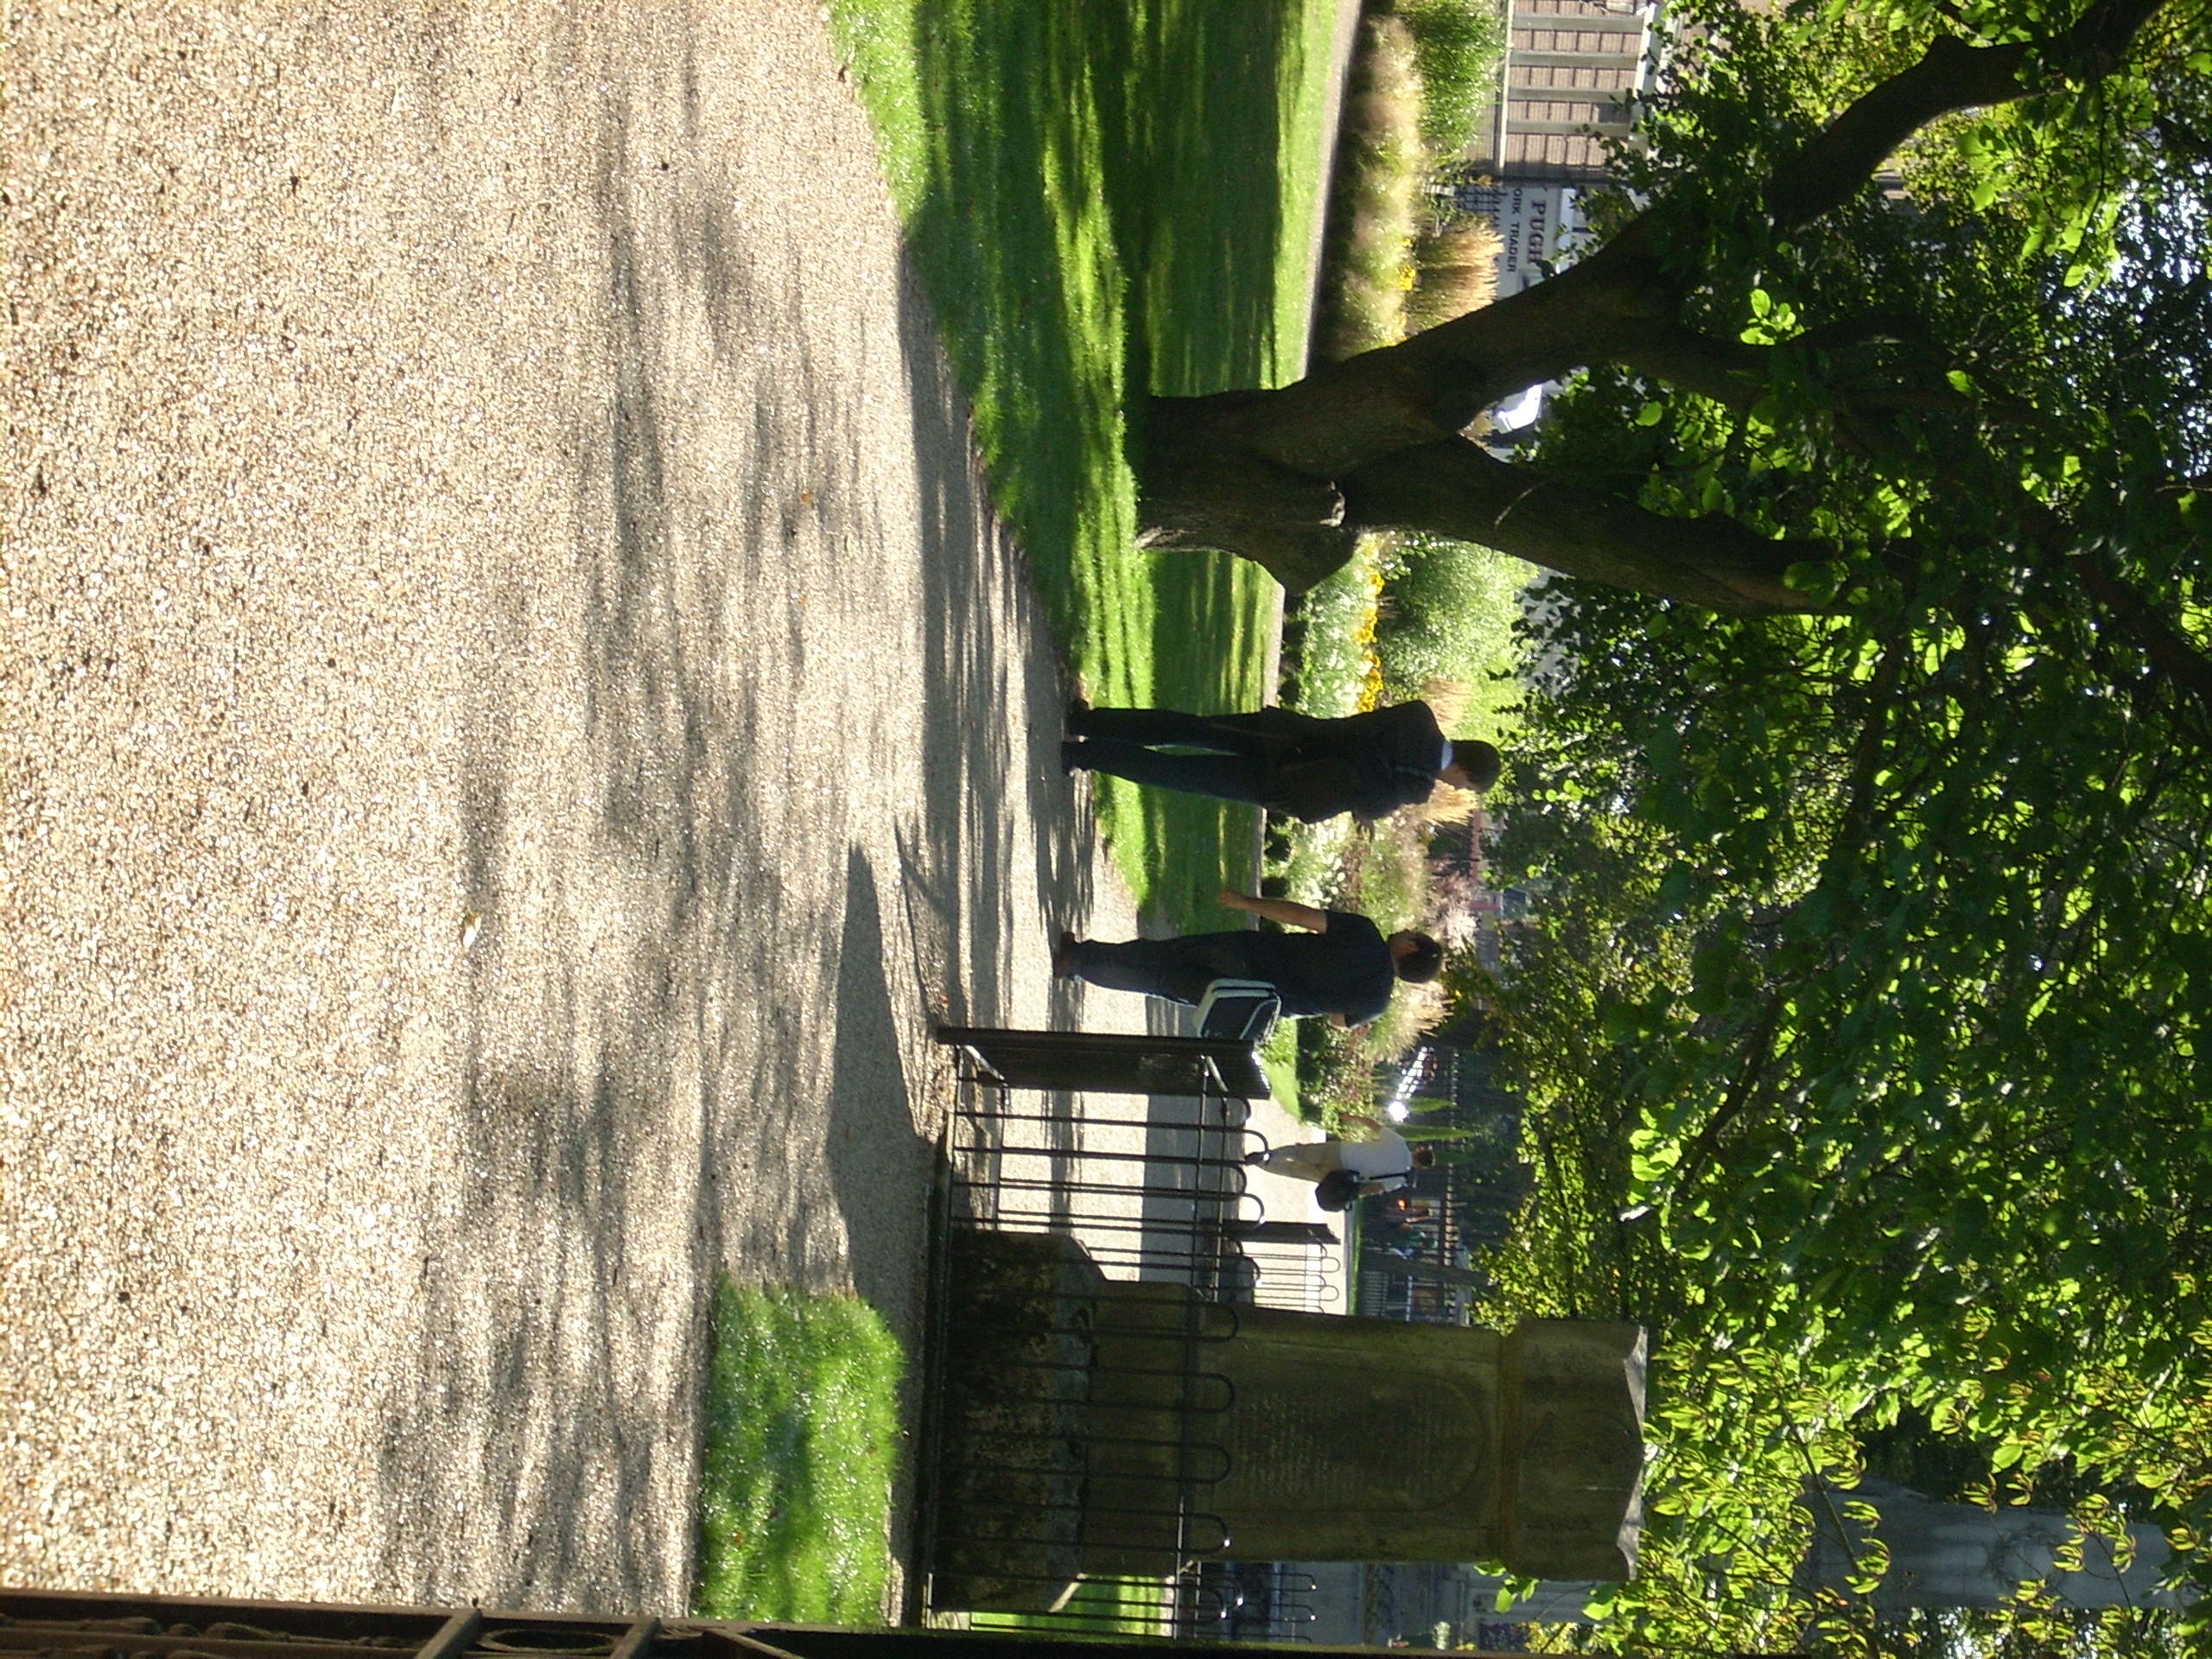
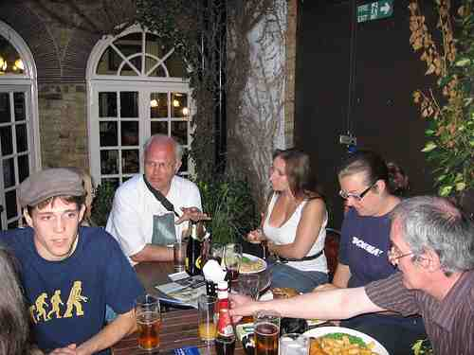
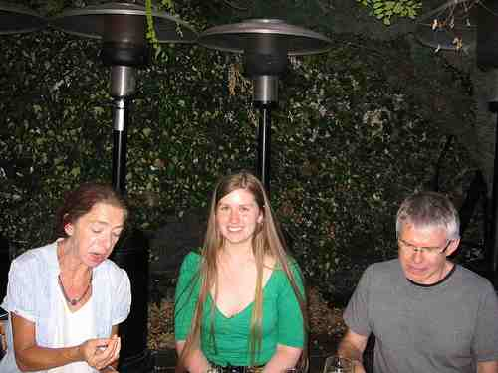
Galaxy Zoo: Green Peas Cardamone et al. 2009
Notes:
Originally noticed in 2007, the orogial work was presented in a paper in 2009, and through a meeting of citizen scientsits & GZ scientsits in 2009.

Slide 3



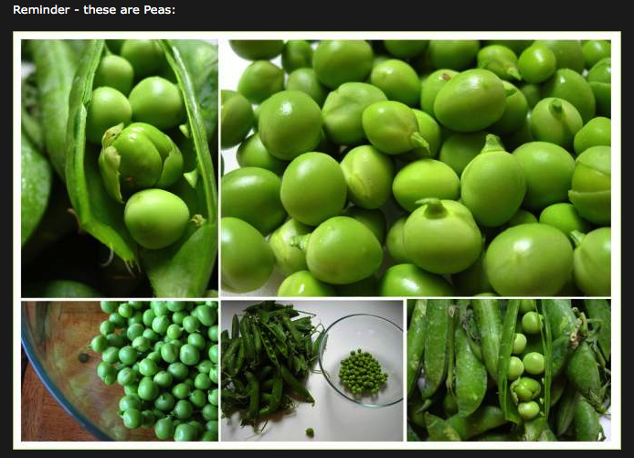
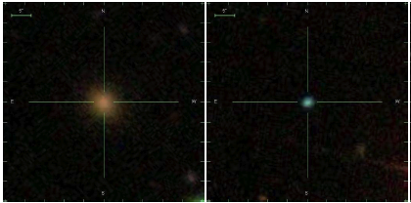
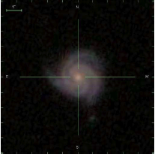
peas of cake !
Do the mushy ones also count?
I'm classifying my bean salad!
Where are the Knights of Ni when you need them?
"We will say 'Ni!' again to you if you do not ap-pea-se us . . .”
what on earth would I do without peas ! Cheesy
Practically Perfect Patching of Peas
Small, Round & Green?
Notes:
Social Impact

Slide 4
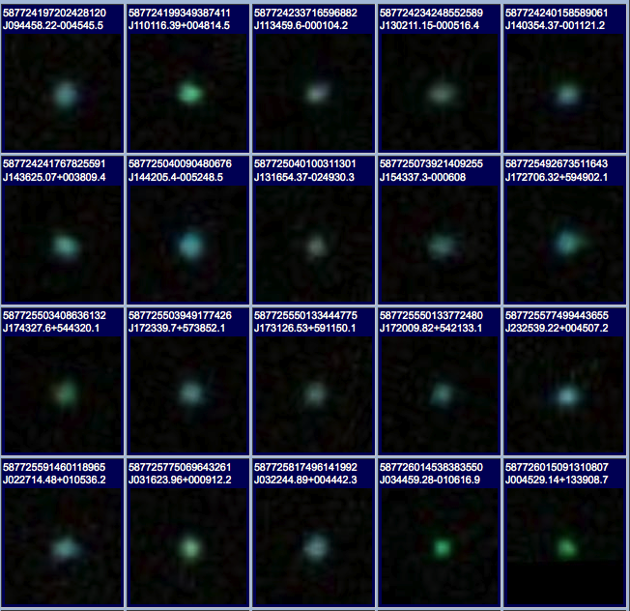
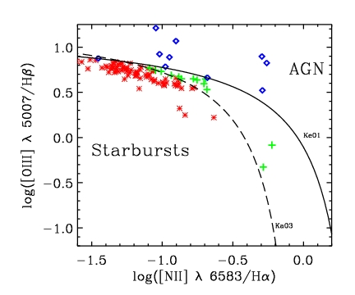
Galaxy Zoo Green Peas: discovery of a class of compact extremely
star-forming galaxies
Cardamone et al. 2009
Notes:
In particular – the unintended consequences (my research!) Story to tell you today.
~200 were found by eye by the ‘Peas Brigade’ - a group of volunteers dedicated to finding these.
The task fell to me: How do these objects fit into our picture of galaxy evolution? Most importantly what can they tell us about how galaxies form?
----
If we start with the assumption that morphology tells us something of the galaxies properties.
So how do we fit these objects into our picture of galaxy evolution - what can they tell us about it?
But
Most peas turned out to be Starburst galaxies,
This was surprising to me, I expected to see AGN.
of lower metalicity (by their location on the BPT plot)
Further looking into their gas phase metalicity revealed numbers near 0.5 solar to nearly solar in some cases.
E(B-V) from the balmer decrement so you can believe

Slide 5
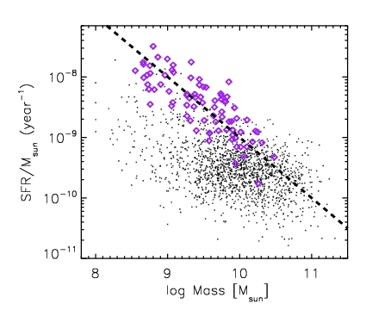
Specific Star Formation Rate
large
Peas
Rate of star formation per unit mass
SFR = 10 M_{sun}yr⁻¹
Galaxy Zoo Mergers
small
large
small
Cardamone et al. 2009
Notes:
Specific star formation rates indicating doubling times of order 1 Gyr or less.

Slide 6
Specific Star Formation Rate
Galaxies from the early Universe
Lyman Break
Galaxies
Lyman-a Emitters
(Gawiser et al. 2006)
Peas
SFR = 10 M_{sun}yr⁻¹
Galaxy Zoo Mergers
after Castro Cerón et al. 2006
Cardamone et al. 2009
Notes:
Specific star formation rates indicating doubling times of order 1 Gyr or less.

Slide 7
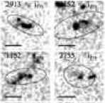
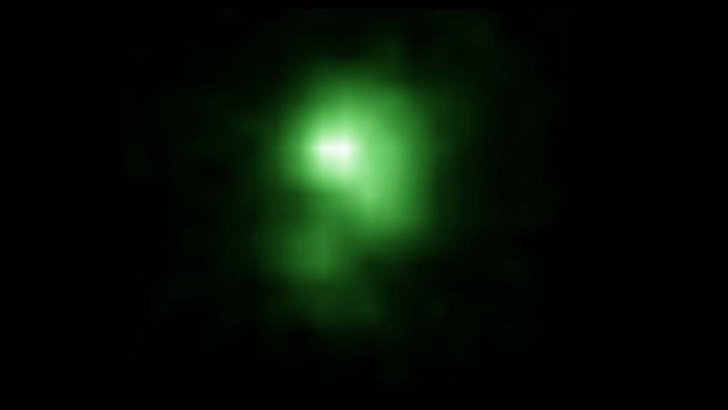
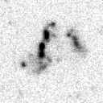
‘Green Pea’ - like galaxies could have reheated the Universe
z~4
J0925+1403 - photons capable of ionizing hydrogen
Overzier et al. 2008
z~2
Z~0.3
Dickinson et al. 1998
Isatov et al. 2016
http://www.sciencealert.com/these-green-pea-galaxies-could-have-reheated-the-universe-after-a-cosmic-dark-age
http://www.nature.com/nature/journal/v529/n7585/full/529159a.html
Notes:
offers clues to how the first generation of galaxies may have reionized hydrogen gas in the early Universe

Slide 8
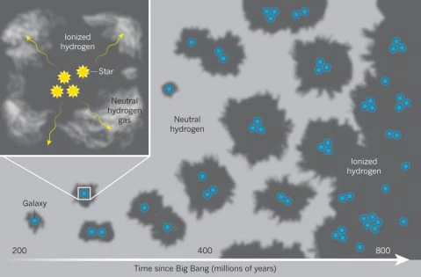
Erb (2016)
http://blog.galaxyzoo.org/2016/01/17/green-pea-galaxies-may-have-been-responsible-for-re-ionizing-the-universe/
Notes:
Lyman continuum photon escape
Without this process we wouldn’t be able to see distant galaxies (neutral hydrogen would absorb the photos before they reach earth). ere have been lots of papers proposing different possible sources for this, including dwarf galaxies, active galactic nuclei, quasars, very early and massive stars, etc.

Slide 9
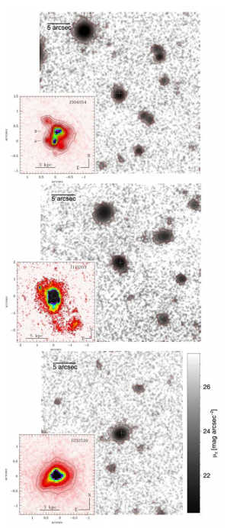
Green Peas cont.
GTC-OSIRIS z’-band
Metal poor (1/5th solar)
High N/O ratios
Low HI column density
High escape fraction ionizing radiation
Very young ages (≤10 Myrs)
Up to 20 % of current mass
Existing old stellar components
Short / Extreme phase of SF
Recent massive inflow of gas
Feedback (Wolf Rayet *s)
HST WFPC2 F606 (R)
Amorin et al. 2010, Amorin et al. 2011, Izotov et al. 2011, Amorin et al. 2012, Hawley 2012, Pilyugin et al. 2012, Chakraborti et al. 2012, Henry et al. 2015, Rutkowski et al. 2017, Greis et al. 2017
Amorin et al. 2012
Notes:
Follow-up studies of the Green Peas and other compact, low-redshift, star forming galaxies have found them to be authentically metal-poor galaxies, with lower oxygen abundances than other star forming galaxies of a similar mass (Amorin et al. 2010, 2011). Several studies have looked in great detail at the abundances of various elements in the Green Peas, something that cannot be done in their high redshift analogs. This has resulted in a variety of interesting results, including the importance of Wolf-Rayet stars in the ionization of the gas in the Green Peas (Hawley 2012, Amorin et al. 2012). They have also been shown to have energetic outflows of gas (Amorin et al. 2012) and have been used to understand the astrophysics regulating the production of Lyman-alpha emission lines (Henry et al. 2015). Their morphologies have been confirmed to be clumpy by HST imaging (Overzier et al. 2010) and results have suggested that star formation in the peas occurs in several separate knots throughout the galaxy (Amorin et al. 2012). Additionally, underlying older stellar populations have been revealed through low-luminosity emission (Amorin et al. 2012a). Their radio emission suggests they have strong magnetic fields, larger than that of the Milky Way (Chakraborti et al. 2012).

Slide 10
UV-Luminous Galaxy Comparison
 | LBG / LαE | The Peas
Redshift | z ~ 3.0 | z ~ 0.2
Low Reddening | E(B-V)~0.05-0.2 (Verhamme et al. 2008) | E(B-V) ≤ 0.2
Compact Morphology | compact/disturbed (Giavalisco et al. 1996, Bremer et al. 2004) | unresolved (SDSS) compact/disturbed (HST)
High Specific Star Formation Rate | ~10s Msun/yr (Carilli et al. 2008; Coppin et al. 2007; Lehmer et al. 2005; Barmby et al. 2004) | ~ 0.3 - 30 Msun/yr
Lower Metalicity | 10-50% solar | ~50% solar
Environment | dense regions (Giavalisco 2002) | under-dense regions
Notes:
Key observation came from galex counterparts - UV luminosities are similar to lyman break galaxies

Slide 11
UV-Luminous Galaxy Comparison
 | LBG / LαE | The Peas
Redshift | z ~ 3.0 | z ~ 0.2
Low Reddening | E(B-V)~0.05-0.2 (Verhamme et al. 2008) | E(B-V) ≤ 0.2
Compact Morphology | compact/disturbed (Giavalisco et al. 1996, Bremer et al. 2004) | unresolved (SDSS) compact/disturbed (HST)
High Specific Star Formation Rate | ~10s Msun/yr (Carilli et al. 2008; Coppin et al. 2007; Lehmer et al. 2005; Barmby et al. 2004) | ~ 0.3 - 30 Msun/yr
Lower Metalicity | 10-50% solar | ~50% solar
Environment | dense regions (Giavalisco 2002) | under-dense regions
Notes:
Key observation came from galex counterparts - UV luminosities are similar to lyman break galaxies

Slide 12
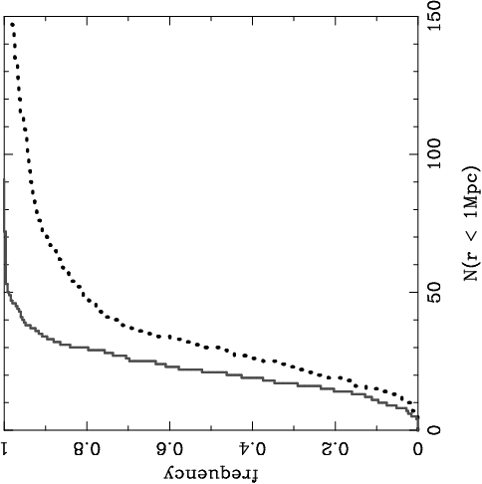
Environments?
Cumulative Distribution
Do peas live in under-dense environments?
Peas
comparison
galaxies
Correlation functions provide a better measure of the 3D environment
Fewer projected neighbors
# of neighbors within 1 Mpc
Cardamone et al. 2009
Notes:
., the median environmental density around peas is less than two-thirds that around normal galaxies, etc. 95% of peas live in environments less dense than those inhabited by at least 33.5% of normal galaxies. Alternatively, at least one-third of normal galaxies live in environments denser than those in which 95% of peas are found.
1 Mpc = 3 Million Light Years

Slide 13
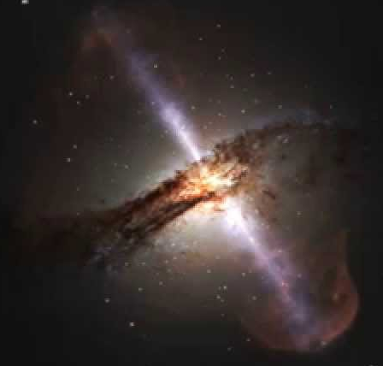

Halo Occupation Distribution
HOD: an empirical model associates galaxies in data with dark matter halos
probability that a halo of mass M harbors N galaxies
Manodeep Sinha’s CorrFunct
Pair counting: form cross correlation function
probability a pair of galaxies are a distance r
https://github.com/manodeep/Corrfunc
via Merry Powell
Notes:
The quantitative measure of clustering is the 2-pt correlation function, which measures the excess probability that a pair of objects is a given distance from each other, over a random distribution.
There are two terms in the correlation function that are dominant on different scales

Slide 14
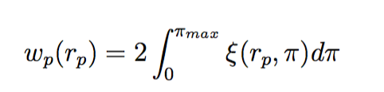
integrate correlation function ξ over line of site component π
W_{p}
r_{p} (Mpc h⁻¹)
Scale (Mpc h⁻¹)
Notes:
The quantitative measure of clustering is the 2-pt correlation function, which measures the excess probability that a pair of objects is a given distance from each other, over a random distribution.
There are two terms in the correlation function that are dominant on different scales

Slide 15
w_{p}(r_{p}) = w_{1-halo}(r_{p}) +w_{2-halo}(r_{p})
Two halo term: at large scale all pairs come from different halos
w_{p,2h}
W_{p}
r_{p} (Mpc h⁻¹)
Scale (Mpc h⁻¹)
Notes:
On large scales, the so-called 2-halo term dominates, which measures the clustering of AGN in individual halos. From this you can estimate the average mass of the dark matter halos that the AGN reside

Slide 16
w_{p}(r_{p}) = w_{1-halo}(r_{p}) +w_{2-halo}(r_{p})
One halo term: at small scales all pairs come from the same halo
w_{p,1h}
w_{p,2h}
Scale (Mpc h⁻¹)
Notes:
On smaller scales, the 1-halo term dominates, which measures the clustering of AGN in the same halo. This constrains the halo occupation distribution of AGN, which ill talk more about in a minute. This hasn’t been done much previoulsy, because need large samples or a large tracer set. but its powerful tool in interpreting the CF on both nonlinear and linear scales, and so we took advantage of it to model our measurement

Slide 17
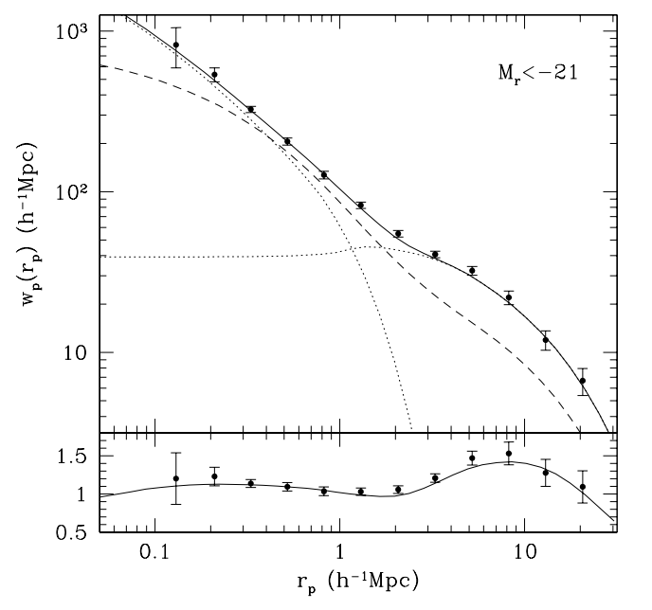
Projected Correlation Function:
integrate correlation function ξ over line of site component π
w_{p,1h}
w_{p,2h}
Zehavi et al. 2004
Notes:
Shown to be more accurate at larger scales (PonsBorderia et al. 1999, Kersher et al. 2000
Simulations suggest that treating the HOD as dunction of halo mass only, independent of large scale environmnet is a good approximation Lemson 7 Kauggman 1999, Berlind et al. 2003
HOD parameters have a non-degenerate effect on galaxy clustering stats 9n-poitn finction, voide probability function, pariwise vel dispersion)
SPH & semi-analytic predictions for the HOD suggest useful to constrained cosmology

Slide 18
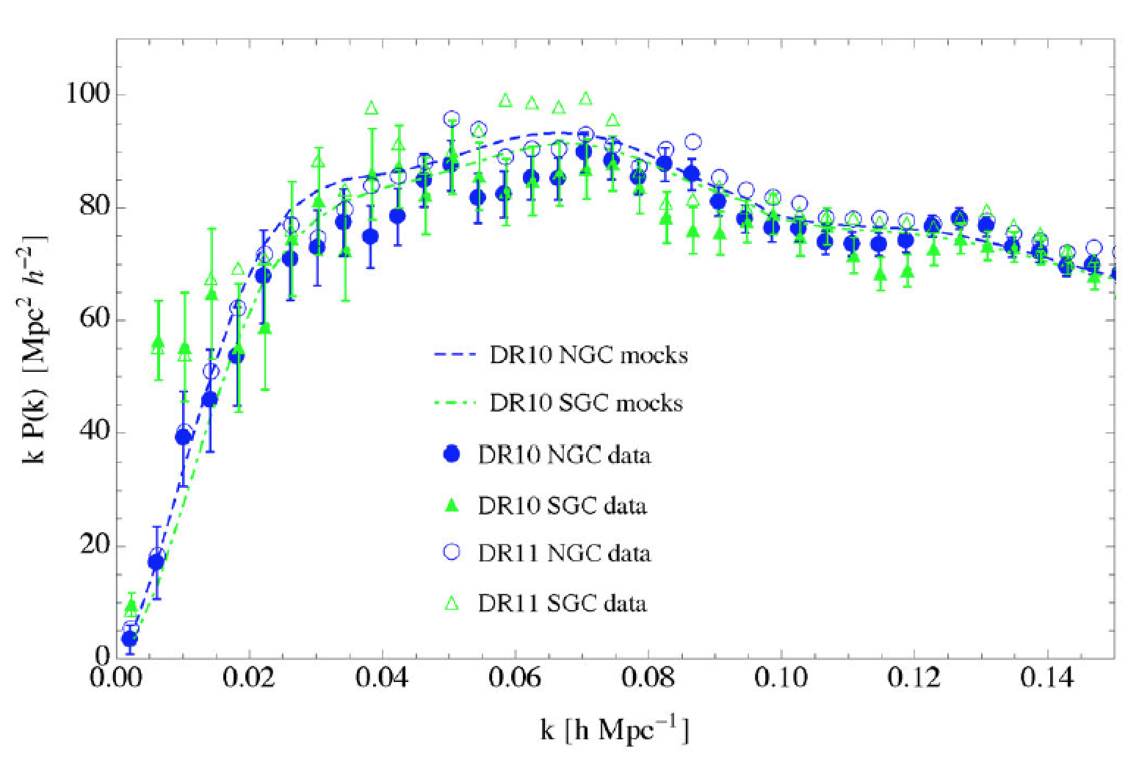
Halo Occupation Distribution
Can constrain a subset of a population
Can use LARGE matched random catalogs
Power spectrum
Manera et al. 2015
Match spatial & redshift distributions of data and reproduce completeness, redshift failures, close pair separations
Notes:
The quantitative measure of clustering is the 2-pt correlation function, which measures the excess probability that a pair of objects is a given distance from each other, over a random distribution.
There are two terms in the correlation function that are dominant on different scales

Slide 19
too few Peas ! (80 from DR7)
40k photometric objects in SDSS meet color/size
Original selection based on Forum IDs
Color avoiding QSOs & Galaxies
band 0.112 < z < 0.36 (OIII in R-band)
SpecLine OIII ew > (a detection in OIII)
psfmag_r > 10 (an r-band magnitude)
Petrorad_r< 5 (not part of an extended source)
GANDALF fits & BPT SF (remove NLSy1s in redder large galaxies)
Notes:
While we were working with the sample, DR7 was released from SDSS
Most peas were targeted as seredipidous sources or faint-quasaes, and were allocated fibers as they were available in a given field. Without a uniform selection, absoulute space density cannot be accurately assessed.
Searching at other redshifts will have interlopers

Slide 20
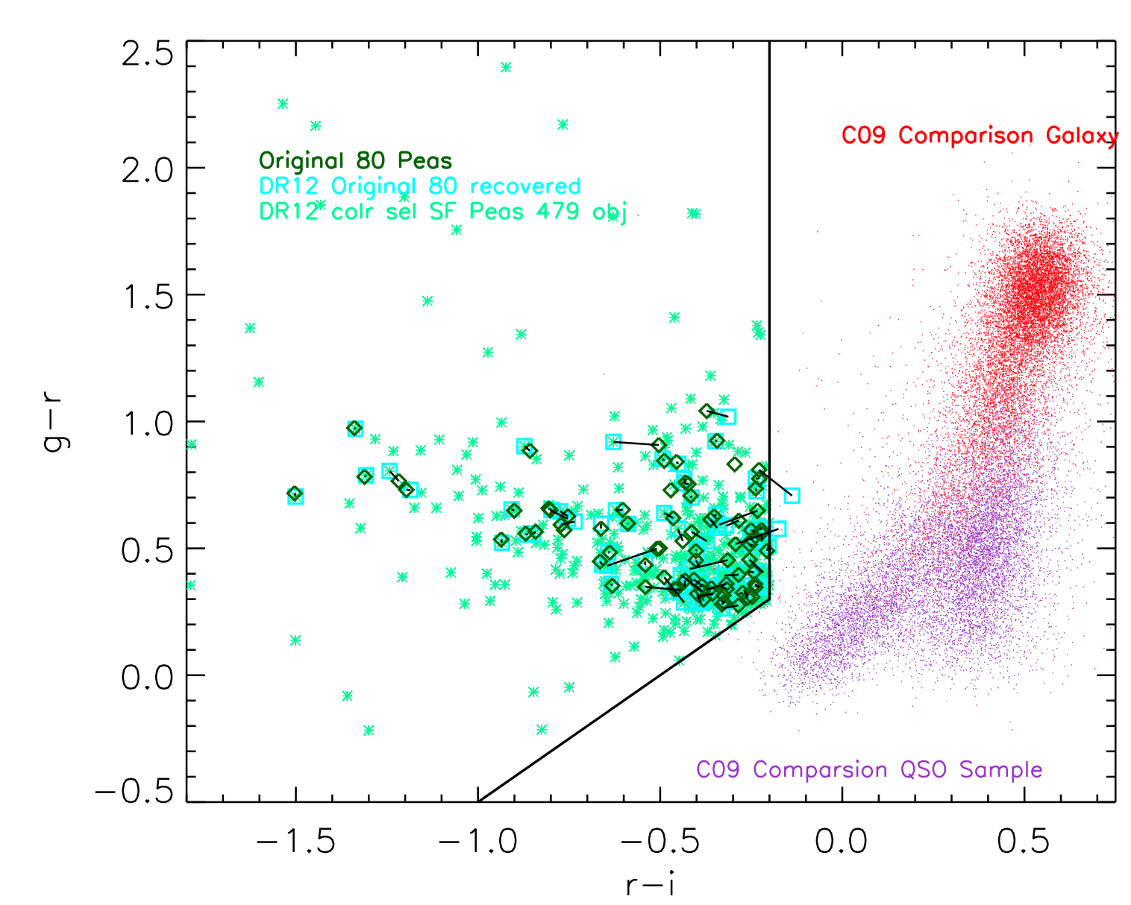
DR12 (in progress) 479 Peas
Of the 75 in Portsmouth Catalog, only 57 are returned as SF
Notes:
NOTE: Photometry pipeline was updated with DR8 and beyond, correcting subtraction near bright galaxies
for DR8 and later releases the photometry was reduced using a new version of the photo pipeline, under rerun “301”.
Most peas were targeted as serendipitous sources or faint-quasars, and were allocated fibers as they were available in a given field. Without a uniform selection, absolute space density cannot be accurately assessed.
Searching at other redshifts will have interlopers

Slide 21
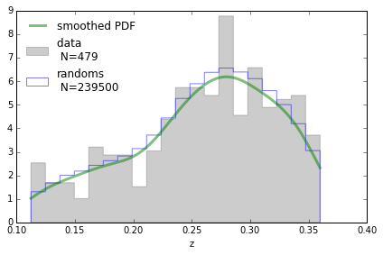
For the peas, can create much larger sample of ‘randoms’ drawn from the same z distributions
Notes:
The quantitative measure of clustering is the 2-pt correlation function, which measures the excess probability that a pair of objects is a given distance from each other, over a random distribution.
There are two terms in the correlation function that are dominant on different scales

Slide 22
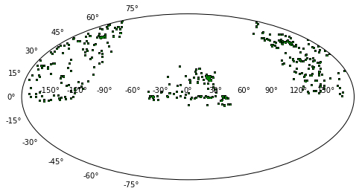
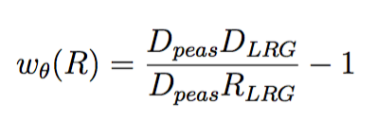
Created Random catalog in RA/DEC non trivial for peas
a) randomly selecting ra/dec varying redshift, b) randomizing +/- 1 degree ra/dec
* Switch to Padamanabhan et al. (2009) estimator
with Meredith Powell

Slide 23
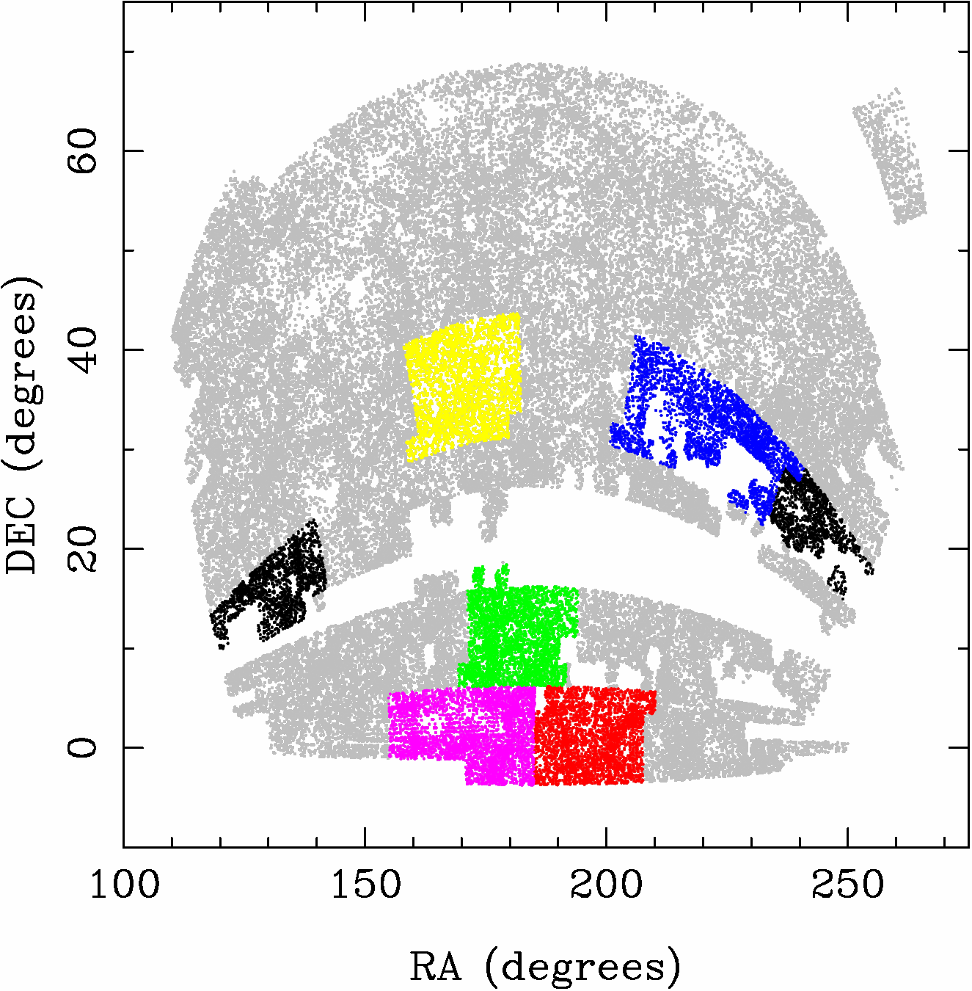
Error Bars are computed by jackknifing the sample
over 13 approximately equal area bins
Figure from:
McBride et al. 2011
Three-Point Correlation Functions of SDSS Galaxies: Luminosity and Color Dependence in Redshift and Projected Space
https://inspirehep.net/record/861431/files/jacksamples_radec_vl_mb20_all.png

Slide 24
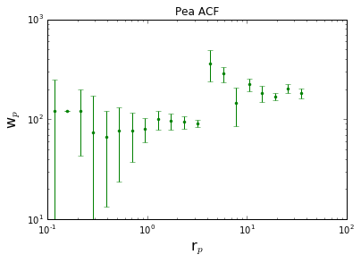
Auto Correlation Function of 479 Peas from DR12
Shape is consistent with horizontal (no clustering signal seen) but uncertain . . .
Small amplitude consistent with less clustered than other galaxy samples
Clearly stats too small for Autocorrelation
Notes:
smaller amplitude than LRGs - > implying less clustered, negative not enough rands

Slide 25
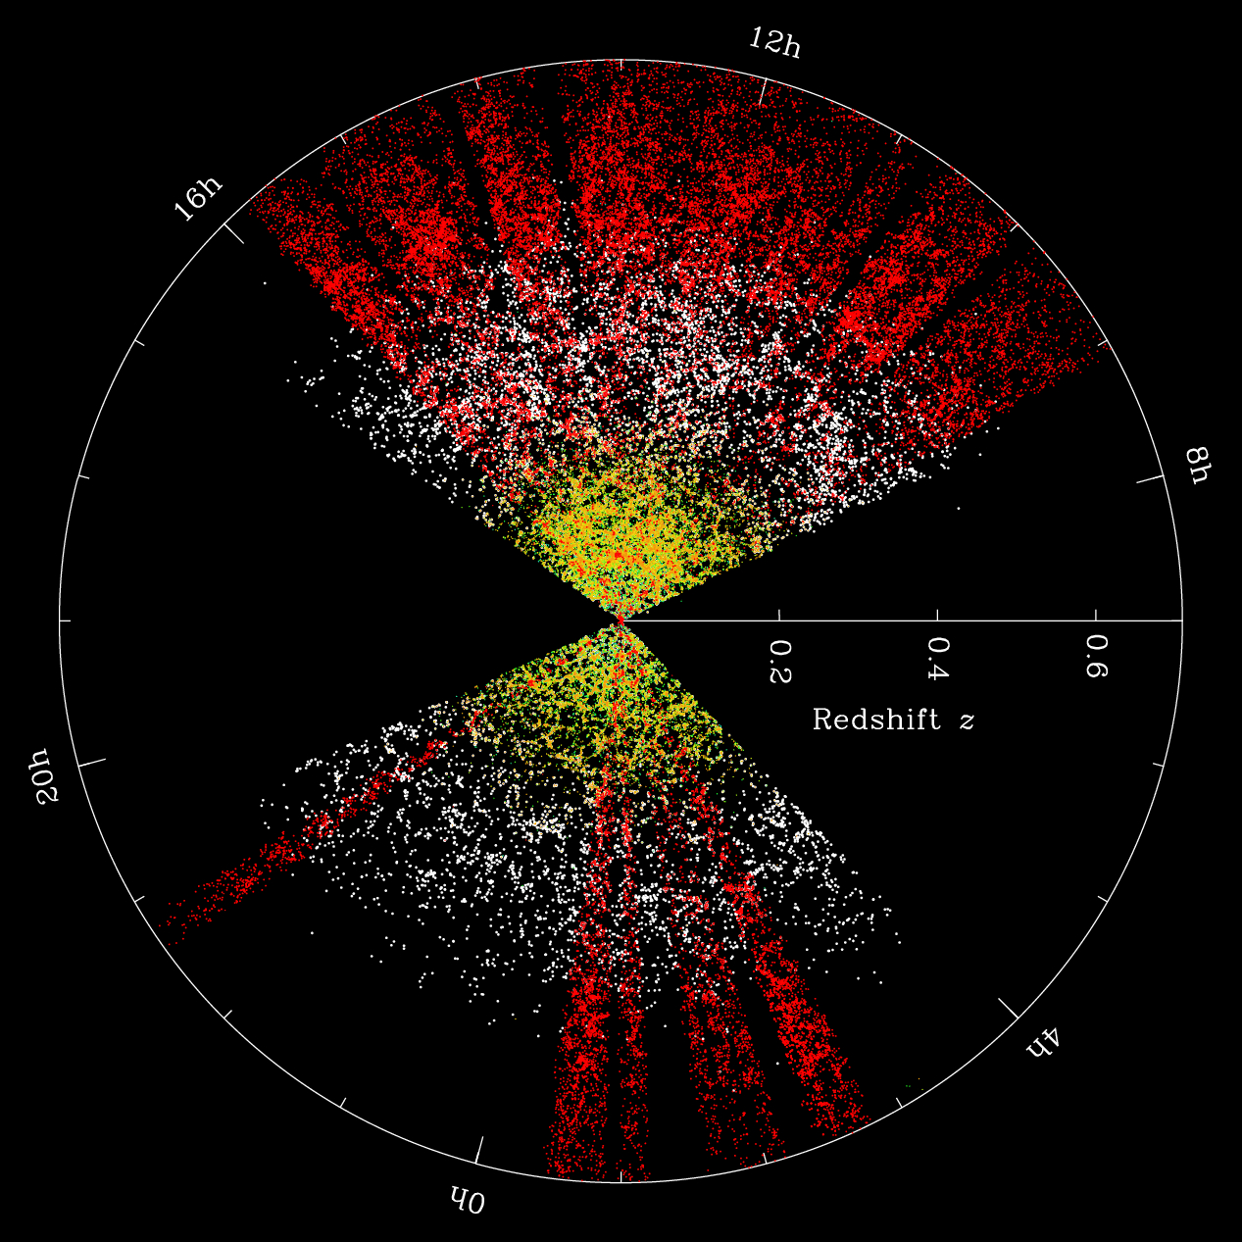
Comparison Sample
Correlation function’s power come from improving statistics by comparing the peas to a well studied sample with higher spatial density.
SDSS
Lowz LRGs
http://wwwmpa.mpa-garching.mpg.de/mpa/research/current_research/hl2012-1/hl2012-1-en-print.html
Notes:
Shown to be more accurate at larger scales (PonsBorderia et al. 1999, Kersher et al. 2000
HOD can be used to constrain any subset of the galaxy population – which can be used to constrain galaxy formation

Slide 26
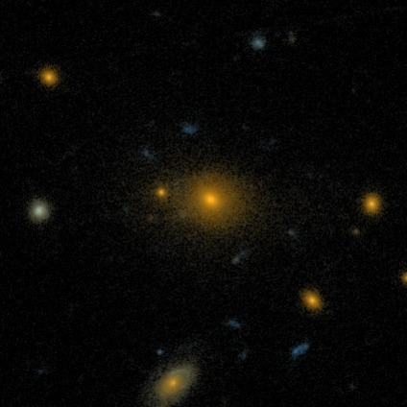
Comparison Sample: Luminous Red Galaxies
Homogenous well studied sample
Successfully constrained cosmological parameters (e.g., Tegmark et a. 2004)
HOD models are good fit (Zehavi et al. 2005, Reid & Spergel 2009, White et al. 2011)
http://wwwmpa.mpa-garching.mpg.de/mpa/research/current_research/hl2012-1/hl2012-1-en-print.html
Notes:
LRGs lie in massive halos (M~10¹³h⁻¹ M_{sun})
Massive DM halos (M~10¹⁵h⁻¹ M_{sun)} can host several LRGs
Note: need to correct for angular and radial selection effects (no two fibers within 55”)
ig. 1: This pie-diagram shows the sky distribution of the BOSS massive galaxies. In red, we show the new BOSS Galaxies that probe to a high redshift (greater distance) than the previous SDSS luminous red galaxy (LRG) sample (shown in white) and the normal (MAIN) SDSS galaxies in yellow.
Image Credit: Michael Blanton and the SDSS-III Collaboration
http://wwwmpa.mpa-garching.mpg.de/mpa/research/current_research/hl2012-1/hl2012-1-en-print.html
http://www.nbcnews.com/id/12801391/ns/technology_and_science-space/t/cosmic-map-highlights-knowledge-gap/#.WV0CMdPyunc

Slide 27
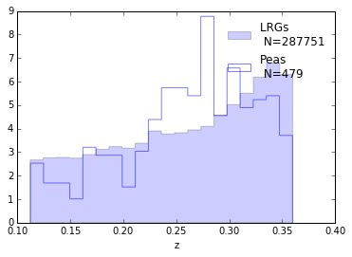
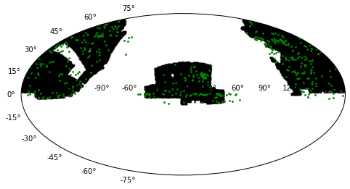
LRG’s well matched in z
Mostly in RA/Dec

Slide 28
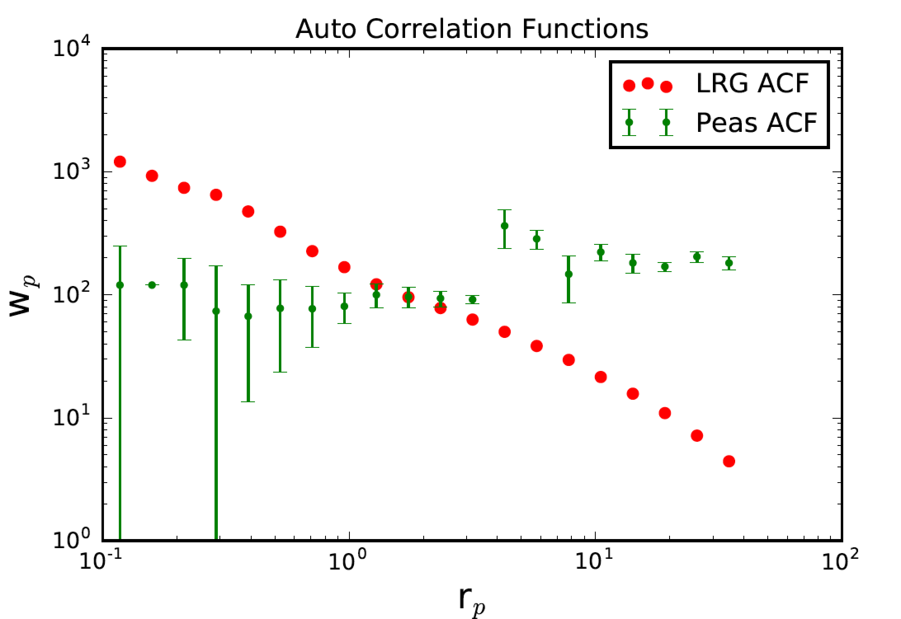
AUTO Correlation function from the LRGs
(sample provided by N Padmanabhan, BOSS)
Smaller amplitude, less clustered?
w_{p,1h}
w_{p,2h}
Notes:
Sample galaxy_DR12v5 LOWZ (N & S) files, limit 0.112<z<0.36, 287751galaxies
Randoms sample (random0_DR12v5_LOWZ: 14,144,530 galaxies,

Slide 29
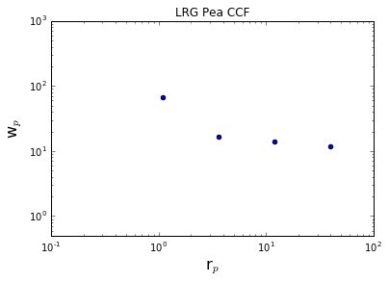
Cross Correlation function – under construction . . . . . .
IN PROGRESS

Slide 30
What’s next?
Suggestions that peas are less clustered than LRG hold consistent w/ previous work.
Questions:
Update to Padamanabhan et et al. (2009) cross-correlation
Update errors from Jackknife to Bootstrapping sample following Padamanabhan et al.
Visiting sample selection – broad but ‘pure’, requiring spectral BPT diagnostics of SF . . .
Characterize bias (halo mass) in comparison to LRGs

Slide 31
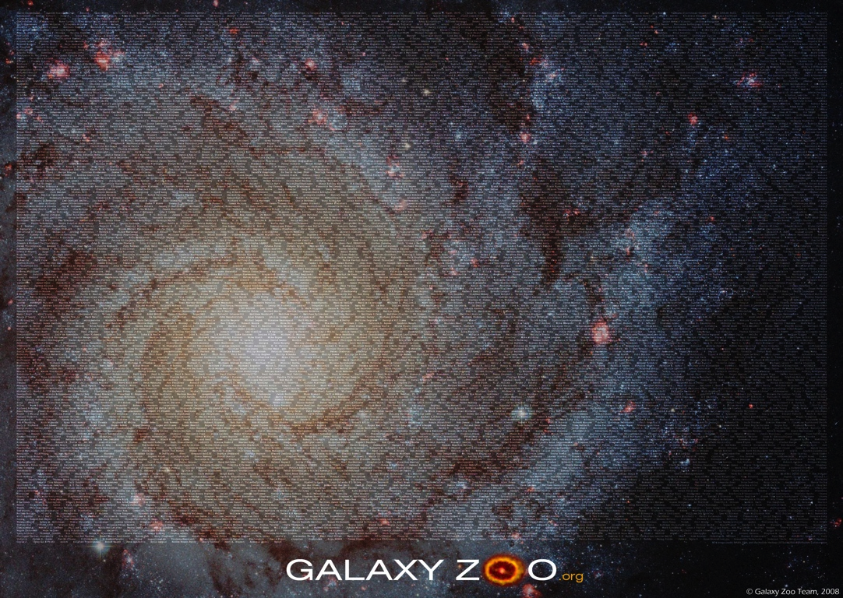

Slide 32
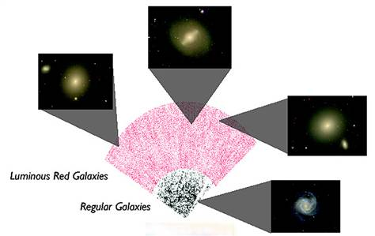
http://www.nbcnews.com/id/12801391/ns/technology_and_science-space/t/cosmic-map-highlights-knowledge-gap/#.WV0CMdPyunc

Slide 33
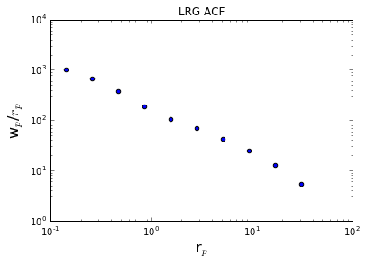
AUTO Correlation function from the LRGs
(sample provided by N Padmanabhan)
Sample galaxy_DR12v5 LOWZ (N & S) files, limit 0.112<z<0.36, 287751galaxies
Randoms sample (random0_DR12v5_LOWZ: 14,144,530 galaxies,
w_{p,1h}
w_{p,2h}

Slide 34
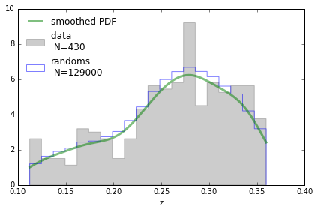
Created Random catalog matched to the peas z distribution.
Smoothed w/ gaussian kernal and drew randoms from smoothed distr
with Meredith Powell

Slide 35
HST Search - PEAS
63 of the 1346 ‘new’ BOSS peas are in HST imaging + 11 of the 24 original peas not in BOSS search result
Trying to get actual data now….
Recent proposals:
Lyman alpha escape in Green Pea galaxies (give peas a chance)
Green Pea Galaxies: Extreme, Optically-Thin Starbursts?
UV Spectroscopy of Lyman Break Galaxy Analogs: A Local Window on the Early Universe
Origin of double peaks in Lyman-alpha spectra: diffuse halos or Lyman continuum leakage?
Unveiling the Dark Baryons II: the First Sample of OVI Emission Imaging
UV Snapshot of Low-redshift Massive Star-forming Galaxies: Searching for the Analogs of High-redshift Clumpy Galaxies

Slide 36
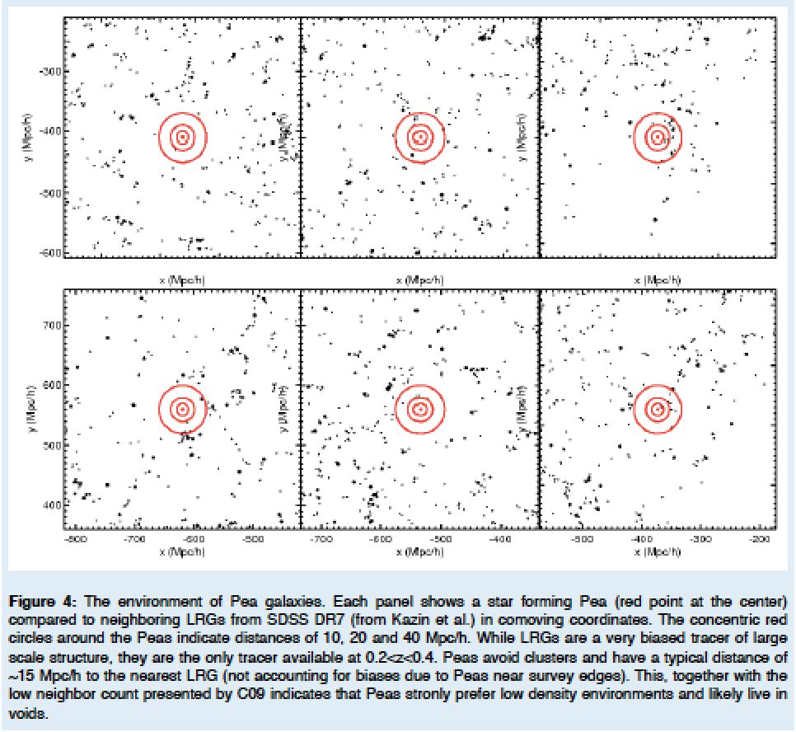
Kevin’s HST SNAP proposal / ~15 Mpc/h to nearest DR7 LRGs
Notes:
(10,20 & 40 Mpc/h) – red circles
Strongly prefer low density environments. . . .

Slide 37
Mapping Environment of Green Peas
Original idea – match peas to a Mock Universe
Looking at abundance matching
e.g., distance to 5th nearest neighbor (W/in Mstar)
e.g., distribution of Neighbors within 1/5 Mpc

Slide 38
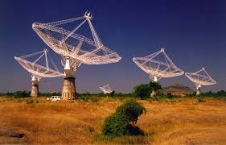
Radio Emission reveals large magnetic field formation in galaxies
VLA Stack of 32 Peas, ~0.1mJy
GMRT observations 1 mJy detection
Pea Magnetic Field Strength
B~36 μG (electron diffusion)
B~39 μG (equipartition)
Milky Way: B~5 μG
Chakraborti, Yadav, Cardamone & Ray 2012
Notes:
Stack VLA FIRST data & follow up with GMRT i(Giant Metrewave Radio Telescope )n India: Radio gives you magnetic fields (+ Xray to back it up)
Stacked VLA data: ~0.1 mJy GMRT detections: ~1 mJy
If galaxies young, this is a problem for ideas of magnetic field growth due to amplification of seed fields by dynomo action over gal life span – observations point towards pregalactic magnetic fields.
Star formation, SNe feedback, particle acceleration, and magnetic field amplification -> VLA stack data from 32 green peas – highest estimated fluxes below FIRST survey data threshold of ~1 mJy (Stacked mean flux is 0.124 +/- 0.027 mJy)
Mean flux systematically suppressed compared to your average star forming galaxy (Could be supressed due to InverseCompt scat off radiation from star burst)
-→ Submitted Chandra proposal last Thursday to nail this from the X-ray side

Slide 39
Searching for Pea Neighbors
Starting with the original sample of 80 peas, looking within 50 Mpc projected
Neighbors found with specz 427
Neighbors in photometric catalog 120595
Neighbors found with photo redshift est 20743
Neighbors found w/ photoz in 1sig of pea z 9844
+ -> photo error class 1 3560
*** only a handful (35) remain if looking within 5 Mpc… ***

Slide 40
Environment
Cumulative Distribution
95% of peas live in environments less dense than those inhabited by at least 33.5% of normal galaxies
Peas
comparison
sample
Do peas live in under-dense environments?
# of neighbors within 1 Mpc
Cardamone et al. 2009
Notes:
Projected density around Peas vs. sample matched in luminosity and redshift
Looked within projected 1Mpc, and imag > -20.5
Projected density around Peas vs. sample matched in luminosity and redshift
Looked within 1Mpc, and imag > -20.5
Peas lie in lower density regions than typical gal at same i-band luminosity
KS test 8 sigma
Median environmental density less than 2/3rds normal galaxies
the median environmental density around peas is less than two-thirds that around normal galaxies, etc. 95% of peas live in environments less dense than those inhabited by at least 33.5% of normal galaxies. Alternatively, at least one-third of normal galaxies live in environments denser than those in which 95% of peas are found.
1 Mpc = 3 Million Light Years

Slide 41
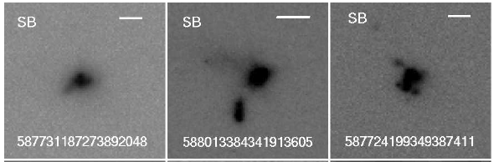
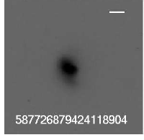
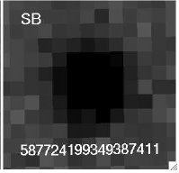
Compact Galaxies
Hubble Space Telescope Images
SDSS
Image
Cardamone et al. 2009
Notes:
Patchy morphology, possibly merging remnents - fans of stars, possibly isolated star forming regions

Slide 42
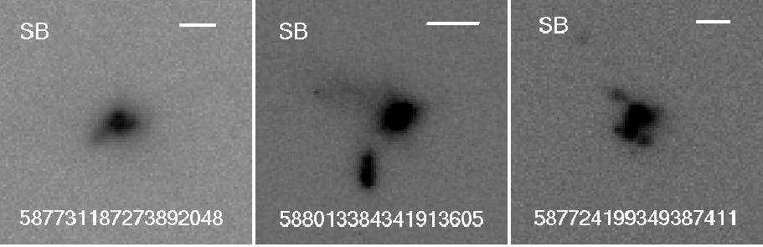
Galaxies in the Early Universe
12 Billion yrs ago
10 Billion yrs ago
Overzier et al. 2008
Dickinson et al. 1998
Hubble Space Telescope Images of Peas
Notes:
# much messier, irregular at higher redshifts, more interactions at higher redshift,more star formation at higher redshift
LBG FROM DICKINSON ET AL 1998, z =2.08 (10 billion years ago) (3.342 Gyrs since BB)
Fig 11 , Overzier et al. 2008, g475 dropouts, z~4.01 (12 billion years ago) (1.571 Gyrs since BB)

Slide 43
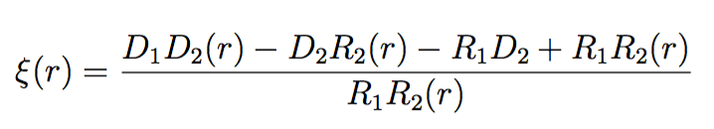
Halo Occupation Distribution
https://github.com/manodeep/Corrfunc
Manodeep Sinha’s CorrFunct
Pair counting: form cross correlation function
probability a pair of galaxies are a distance r
e.g., Padamanabhan (2009) estimator
e.g., Landy-Szalay (1993) estimator
Notes:
The quantitative measure of clustering is the 2-pt correlation function, which measures the excess probability that a pair of objects is a given distance from each other, over a random distribution.
There are two terms in the correlation function that are dominant on different scales

Slide 44
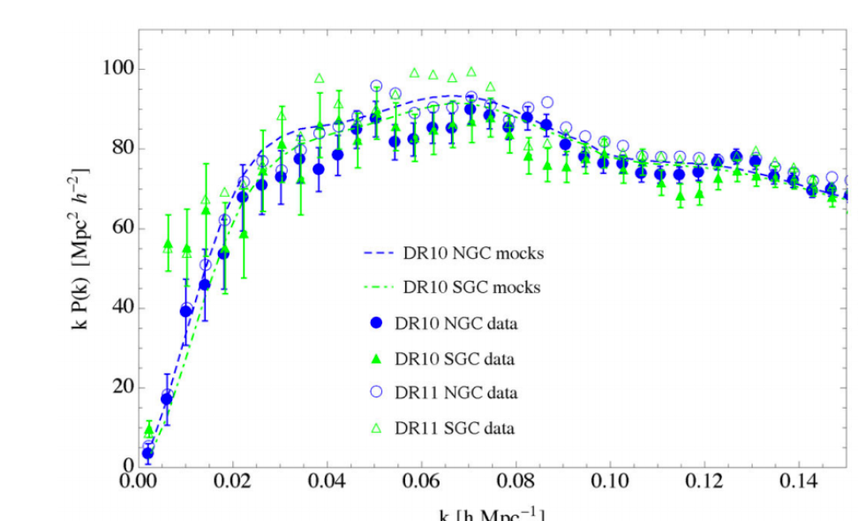
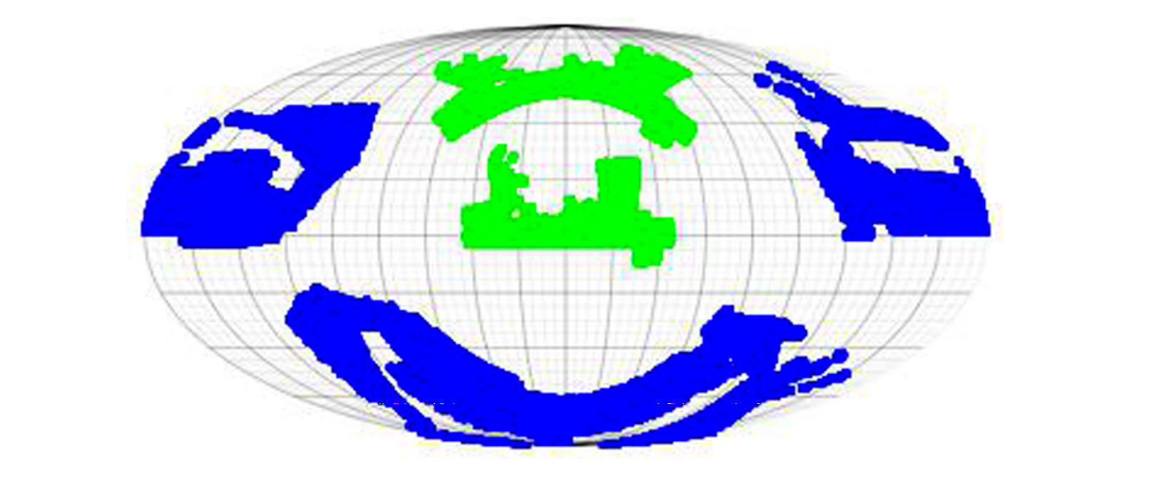
Halo Occupation Distribution
Randoms Catalogs Created to match spatial and redshift distributions of data
Power spectrum
Subsampled to reproduce target completeness, redshift failures, close pair separations.
Manera et al. 2013 and Manera et al. 2015
Notes:
The quantitative measure of clustering is the 2-pt correlation function, which measures the excess probability that a pair of objects is a given distance from each other, over a random distribution.
There are two terms in the correlation function that are dominant on different scales

Slide 45
Halo Occupation Distribution
HOD: an empirical model that associates galaxies in the data with dark matter halos
probability that a halo of mass M harbors N galaxies
Cross-correlation Function: excess probability of finding a pair of galaxies at a distance r 1 r2,\
Landy-Szalay (1993) estimator
Manodeep Sinha’s CorrFunct
https://github.com/manodeep/Corrfunc
D1,R1 – Peas data & random sample
D2,R2 – Comparison galaxy & random sample
Notes:
Shown to be more accurate at larger scales (PonsBorderia et al. 1999, Kersher et al. 2000
HOD can be used to constrain any subset of the galaxy population – which can be used to constrain galaxy formation

Slide 46
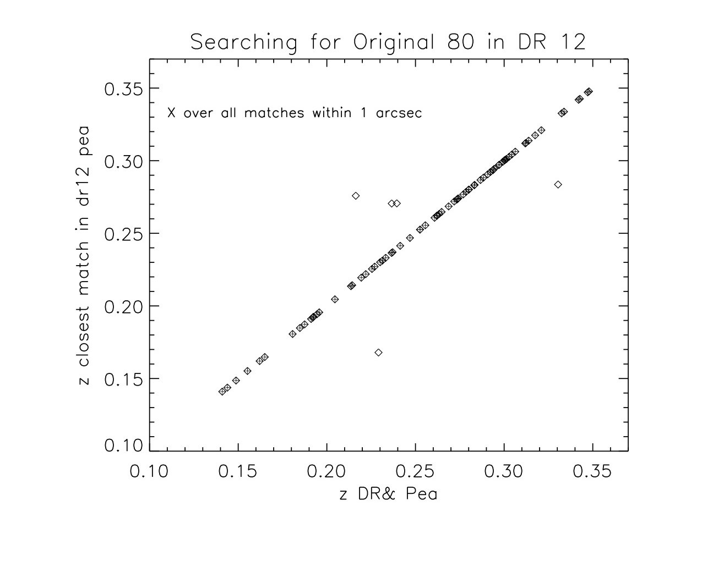
Expanding to DR12
5 not included in Portsmouth catalog
Of the 75 in the catalog, only 57 are returned as SF in Portsmouth Catalog
(1 blank, 3 LINER, 4 composite, 3 Seyfert/LINER, 7 Seyfert)
Notes:
NOTE: Photometry pipeline was updated with DR8 and beyond, correcting subtraction near bright galaxies
for DR8 and later releases the photometry was reduced using a new version of the photo pipeline, under rerun “301”.

